Slide 1
Poster
Manhattan University
Saint Mary’s College
Nolan French, Luke Olmos, Renata Krivenko, Jimmy Hernandez, Connor Li, Oliver Cheng, Alireza Darvishzadeh

Slide 2

Meet The Team

Slide 3
“How do projections of public sector debt through 2030, based on key economic indicators, guide strategic long-term real estate investments in debt-resilient OECD countries?”
Research Question

Slide 4
Methodology
Data Collection & Analysis
Trend Analysis
Regression & Feature Analysis
Clustering
ARIMAX Forecasting
Recommendations

Slide 5
Limitations
Missing Data: Gaps in key variables like education spending (halted by World Bank in 2022) and lack of data for Colombia.
Multicollinearity: Overlap between variables (e.g., population vs. urban growth) may skew results.
Model Gaps: Important variables like inflation were statistically insignificant (p = 0.2092) despite real-world relevance.
Real-World Limitations: Qualitative factors like regulation and geopolitics were not fully captured by models.
Assumption Risk: High debt isn't always negative—countries like Japan show exceptions.
Investor Diversity: The model doesn’t account for differing investor risk tolerances or strategies like distressed asset investing.
Hassan Khoury ©

Slide 6
Data
19 datasets were used, sourced from the OECD, World Bank, World Population Review, and Transparency International.
3 outsourced
Data range: 2010–2023 for 37 OECD countries (excluding Israel); pre-2010 data was removed.
Key variables included GDP growth, inflation, unemployment, corruption, wages, and trade metrics.
Data cleaning and preprocessing were done in Python (Google Colab) using libraries like pandas.
Target variable: Public Sector Debt (% of GDP); features were statistically significant economic indicators.
Countries were grouped into European (26) and non-European (11) for regional analysis.
Hassan Khoury ©

Slide 7
K-Means Clustering
Economic uncertainty from the Eurozone Crisis and COVID led to rising debt pressures.
K-means clustering was used to analyze 19 factors with Debt-to-GDP as the target.
How many outside datasets?
Countries were grouped into two tiers based on debt management performance.
Tier 1 countries showed strong economic performance and debt resilience.
Tier 2 countries underperformed and lacked debt resilience.
Tier 2 was excluded to reduce outliers and improve data accuracy.
Hassan Khoury ©

Slide 8
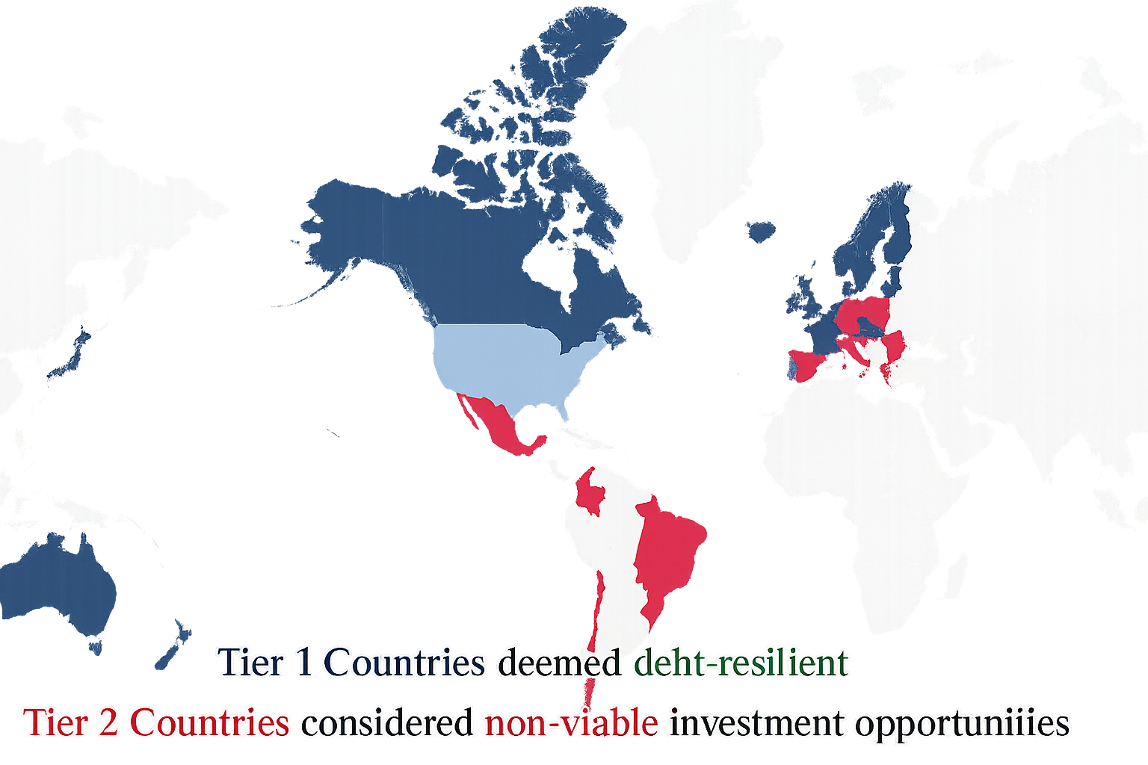
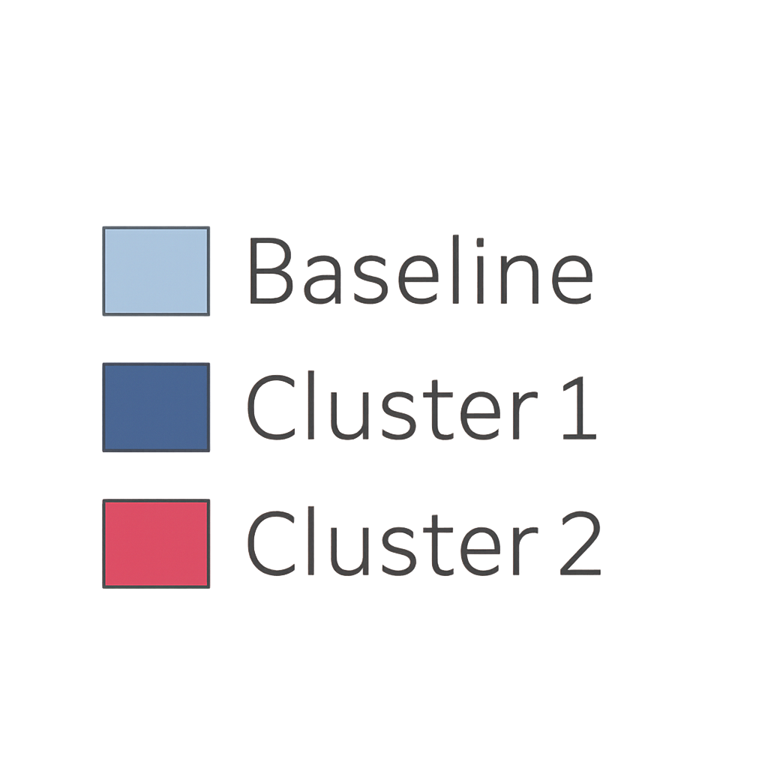
Clustering

Slide 9
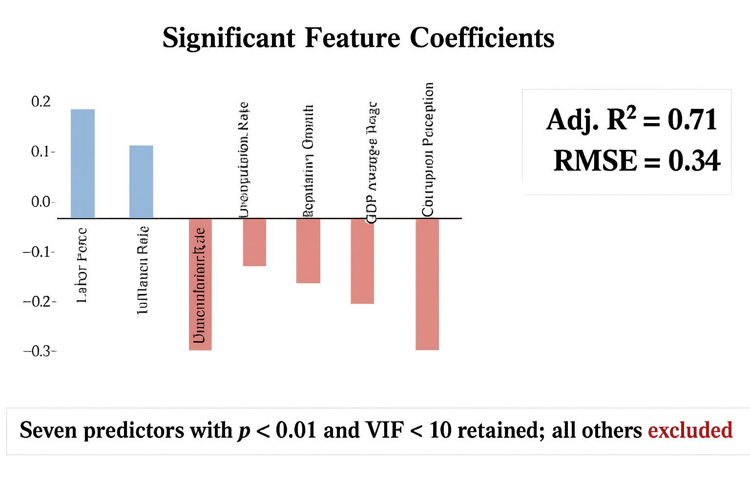
Linear Regression
Linear regression was used to analyze all 19 factors influencing debt.
Seven key factors were identified (p < 0.01, VIF < 10): labor force, inflation, unemployment, population, wage, GDP per capita, and corruption.
These factors were used to build a predictive model for forecasting debt to 2030.
The model achieved an adjusted R-squared of 0.71.
Hassan Khoury ©

Slide 10
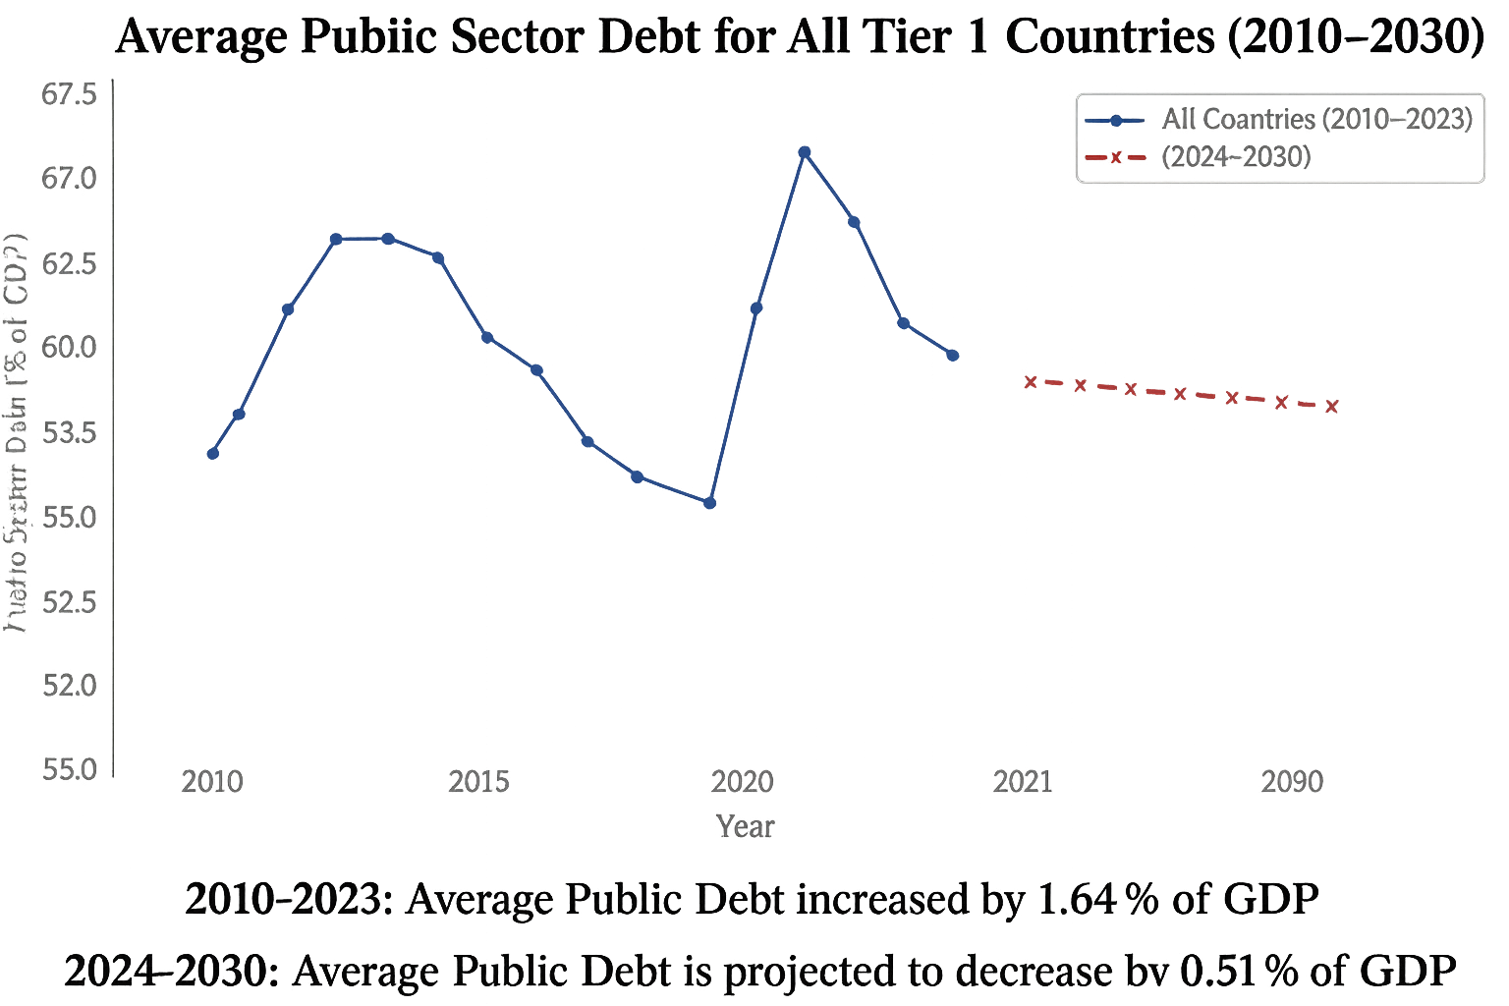
ARIMAX Forecasting
Significant correlations (p < 0.01) were used to create normalized weights for each factor’s impact on debt.
Seven key drivers identified: labor force, inflation, unemployment, population, wage, GDP per capita, and corruption.
ARIMAX was used for forecasting 2024–2030 based on these key variables.

Slide 11
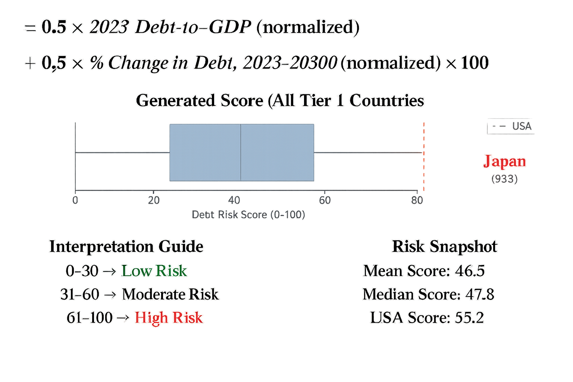
Scoring
FIX THISA Debt Risk Score was used to rank OECD countries for investment potential.
Score ranges: 0–30 = low risk, 31–60 = moderate risk, 61–100 = high risk.
Low-risk countries are considered strong investment opportunities.
High-risk countries are seen as unstable and less attractive for investment.
OECD regions were ranked by the average Debt Risk Score of countries within each region.

Slide 12
Debt Risk By Region
FIX THIS

Slide 13
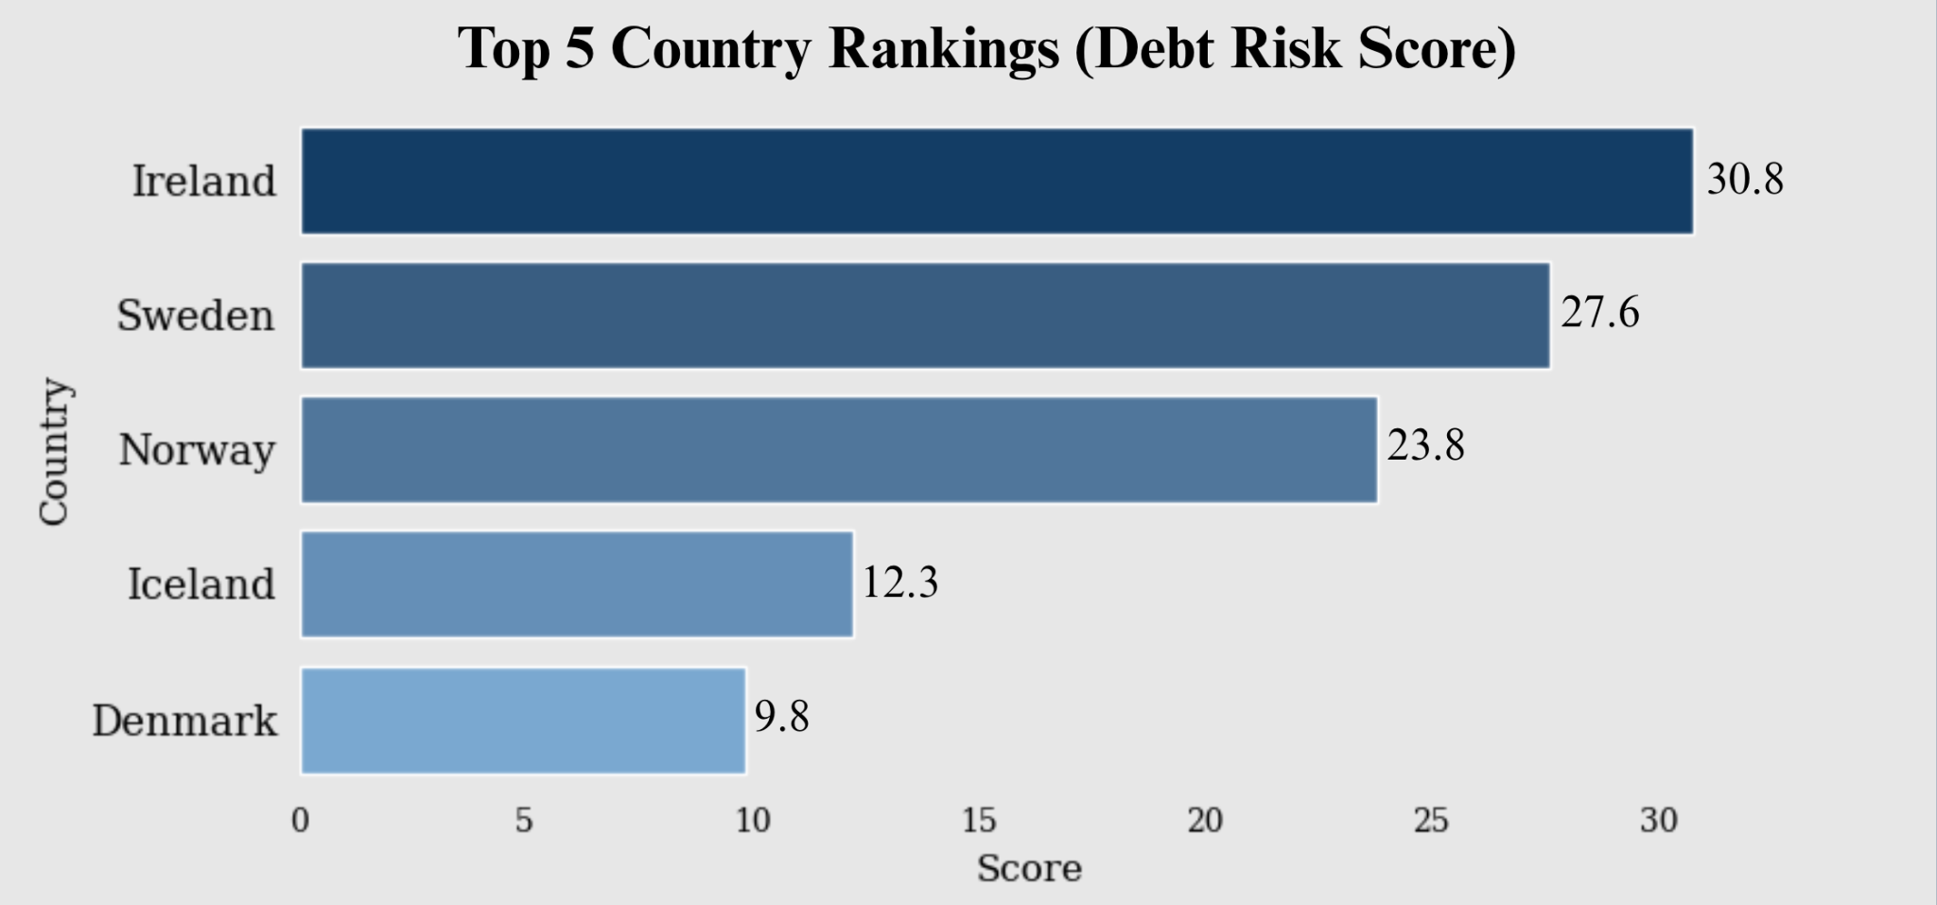
Assessing Investment Risk
We advise Horizon to invest in Northern Europe
Debt is projected to fall by 5.03% of GDP by 2030
Lower impacts from public sector debt

Slide 14
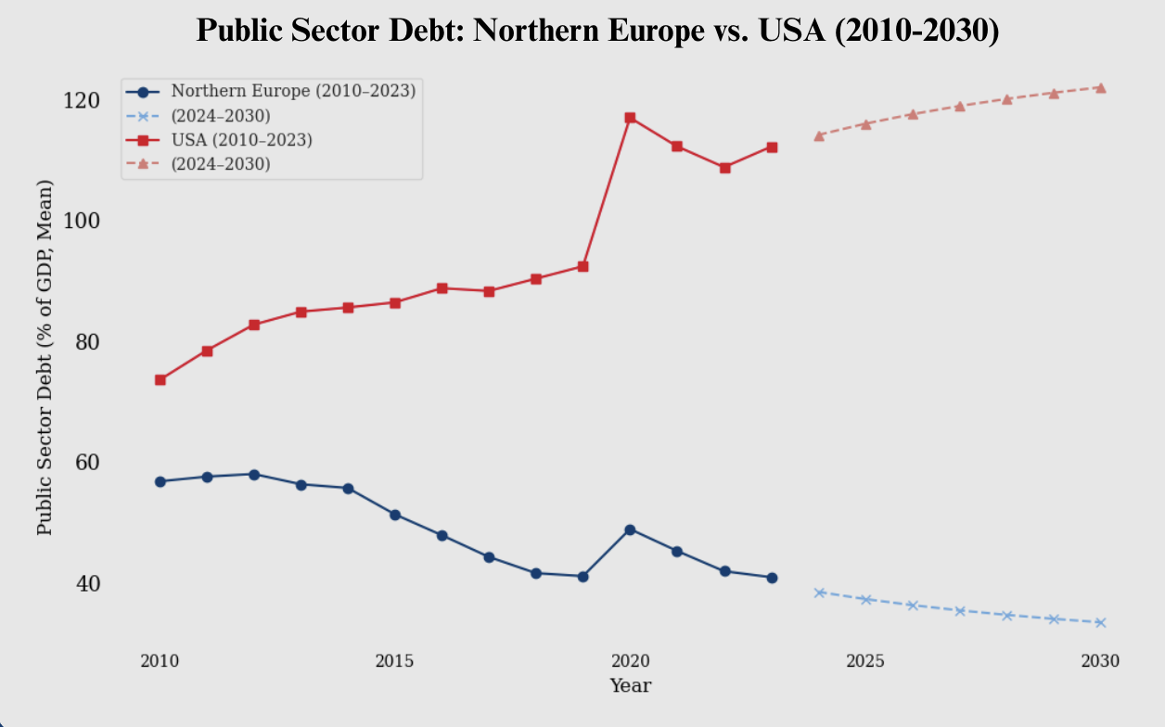
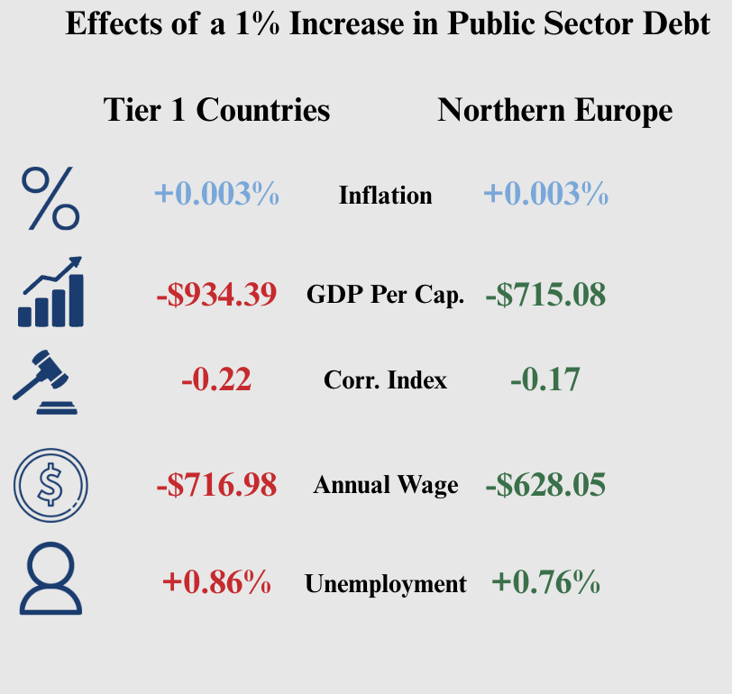
Conclusions
Hassan Khoury ©

Slide 15
Conclusions cont.
From 2010–2023, Northern Europe maintained lower and decreasing public debt, while USA debt steadily increased.
By 2030, Northern Europe is projected to reduce debt further, while USA debt is forecasted to rise.
Overall, Northern Europe shows stronger resilience to debt increases than other Tier 1 countries.
A 1% increase in public debt leads to:
+0.003% inflation in both Tier 1 and Northern Europe.
GDP per capita drop: –$934.39 (Tier 1) vs. –$715.08 (Northern Europe).
Corruption index worsens: –0.22 (Tier 1), –0.17 (Northern Europe).
Annual wages fall: –$716.98 (Tier 1), –$628.05 (Northern Europe).
Unemployment rises: +0.86% (Tier 1), +0.76% (Northern Europe).
Hassan Khoury ©

Slide 16
Recommendations
Based on what the Data has revealed to us, Horizon Real Estate should invest within the Northern European countries such due to their stable economies and low debt fluctuation from year to year.
Hassan Khoury ©

Slide 17
Next Steps
Crisis Management Research
Analyze Omitted Features
Evaluate Excluded Variables
Check out the variables that were barely under our p of <0.01
Could experiment with funky combos or curves to further analyze what's important
Could possibly use Random Forest or XGBoost to uncover surprises
As of now, only 7 significant factors out of all cause our regression
Drop in governance scores such as corruption, rule of law
Add shock factors like oil prices or exchange‑rate swings
Run each one alone within our regression & ARIMAX to see which actually matters
Use data from previous crises to derive insights on how to manage issues in the future
Apply same framework to different set of data that may be correlated in crisis eras.

Slide 18
Thank You! Any Questions?

